Slide 1
DO WE KNOW WHO WE ARE?
MORE THAN A RETHORICAL QUESTION...
Carlo Alberto Ravazzolo
SCM M&S Expert – SCM SVP Professional Assistant
11/03/2015 – Veszprém

Slide 2
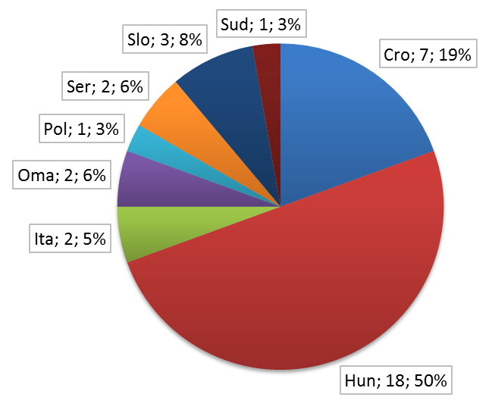
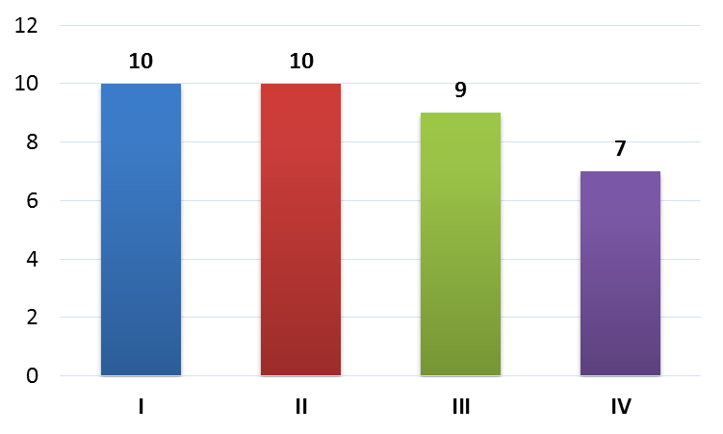
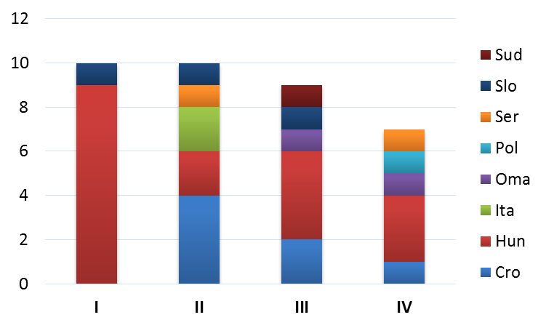
Participants
How many? And from where?

Slide 3
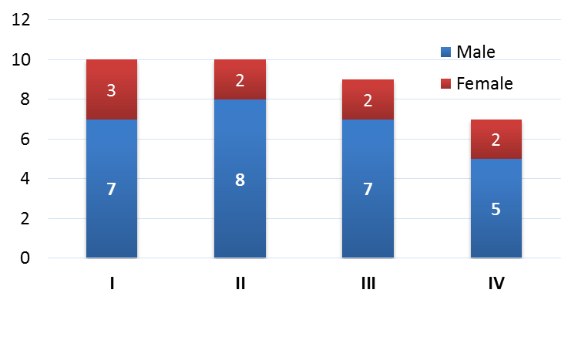
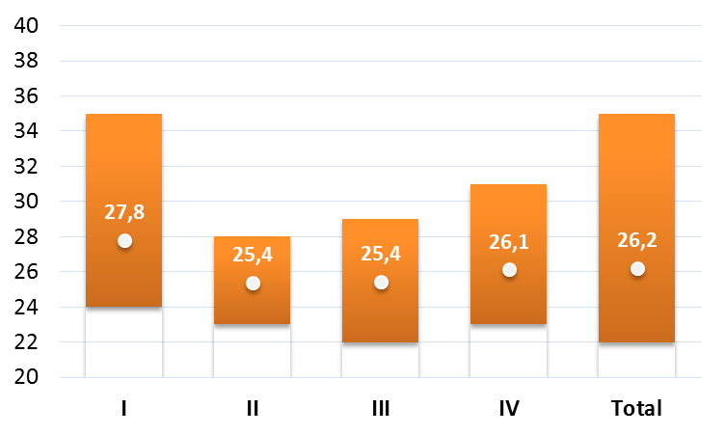
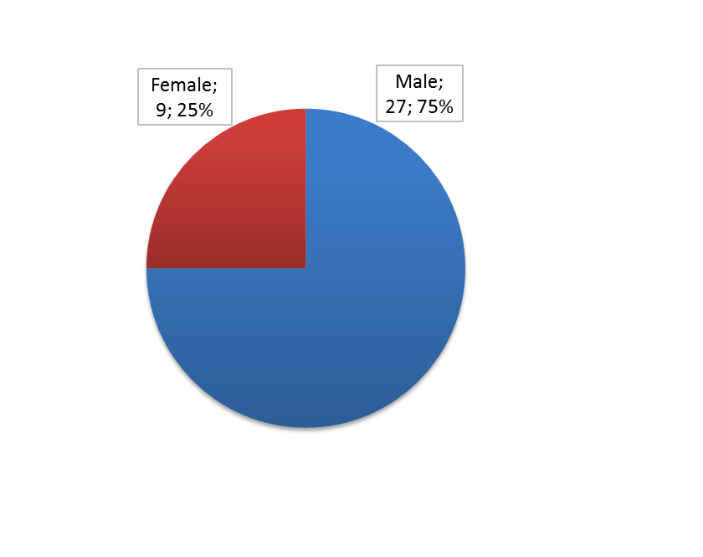
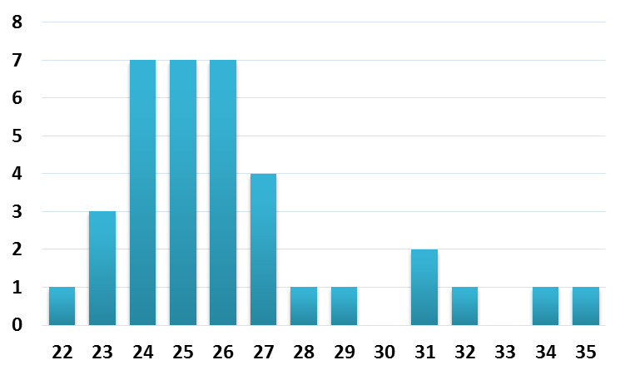
Gender and age
Ladies and gentlemen...

Slide 4
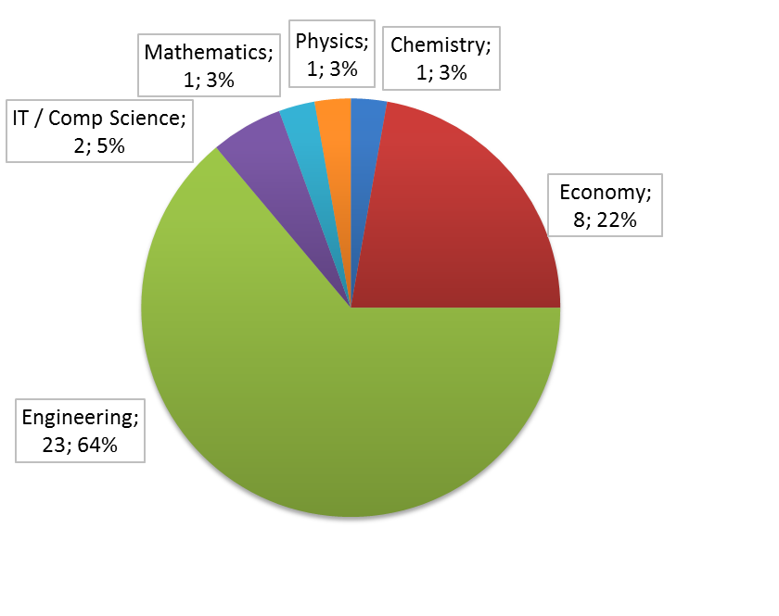
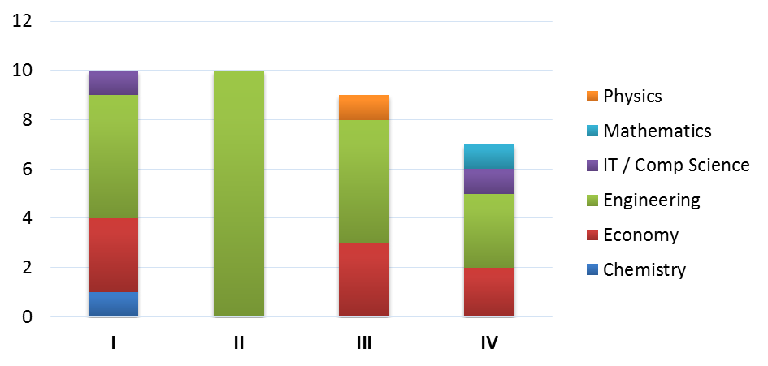
Academic background
Which studies before PIMS academy?

Slide 5
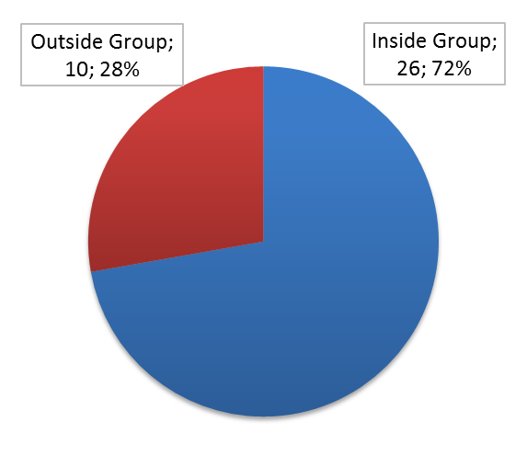
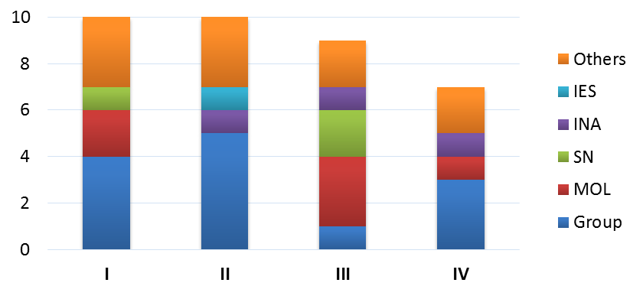
Current employer
The work after PIMS Academy...

Slide 6
What else to say?
Let’s make the pictures talk...

Slide 7
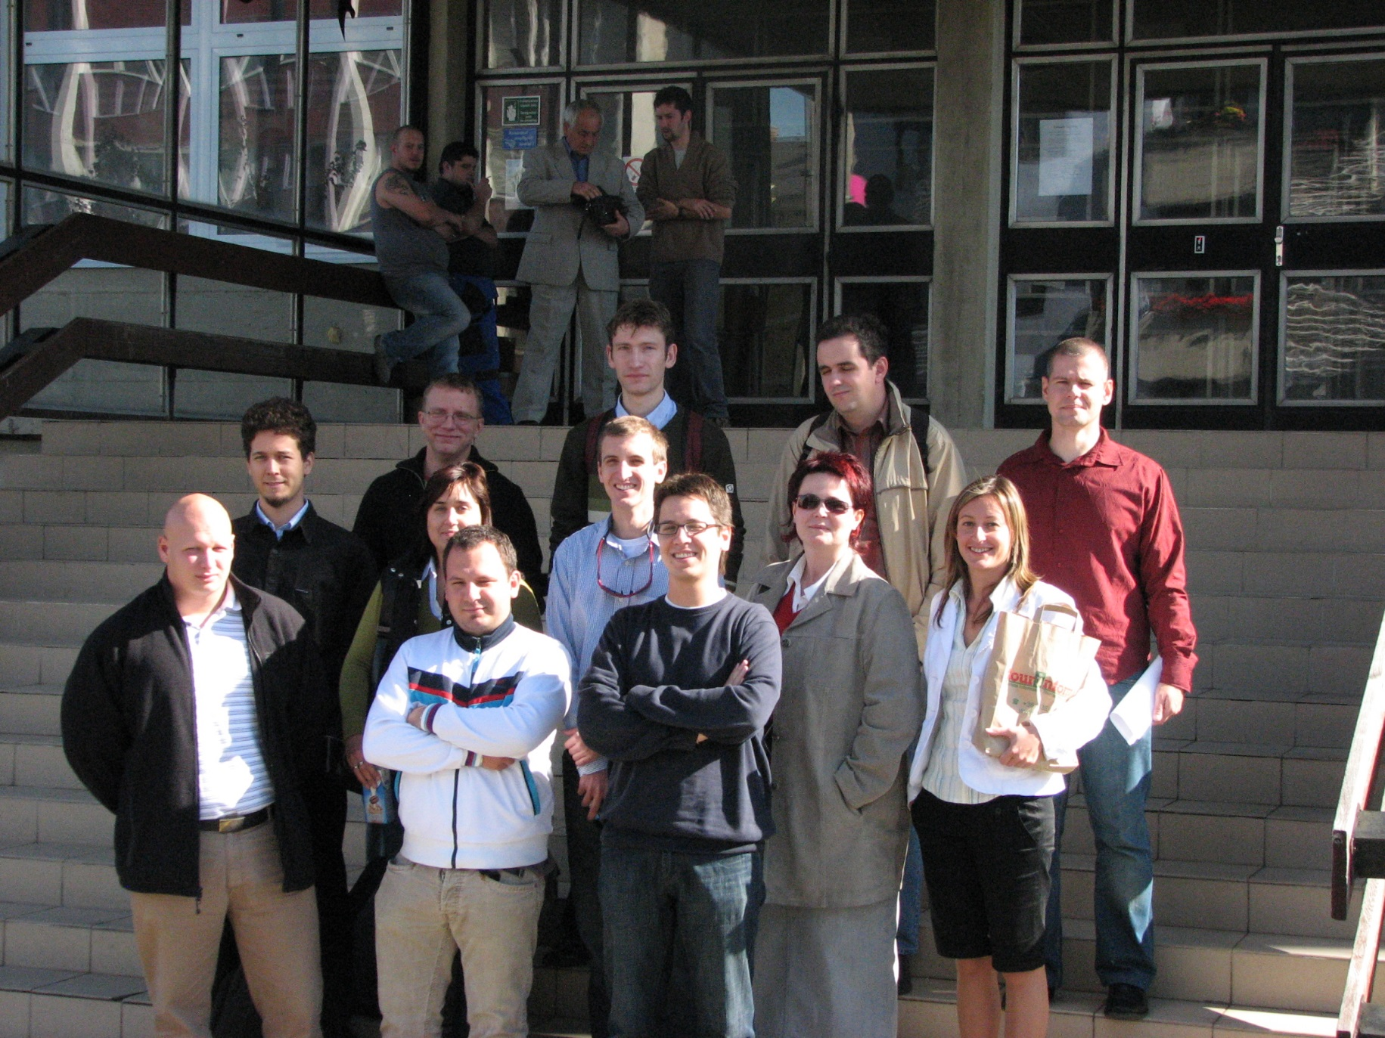
I edition

Slide 8
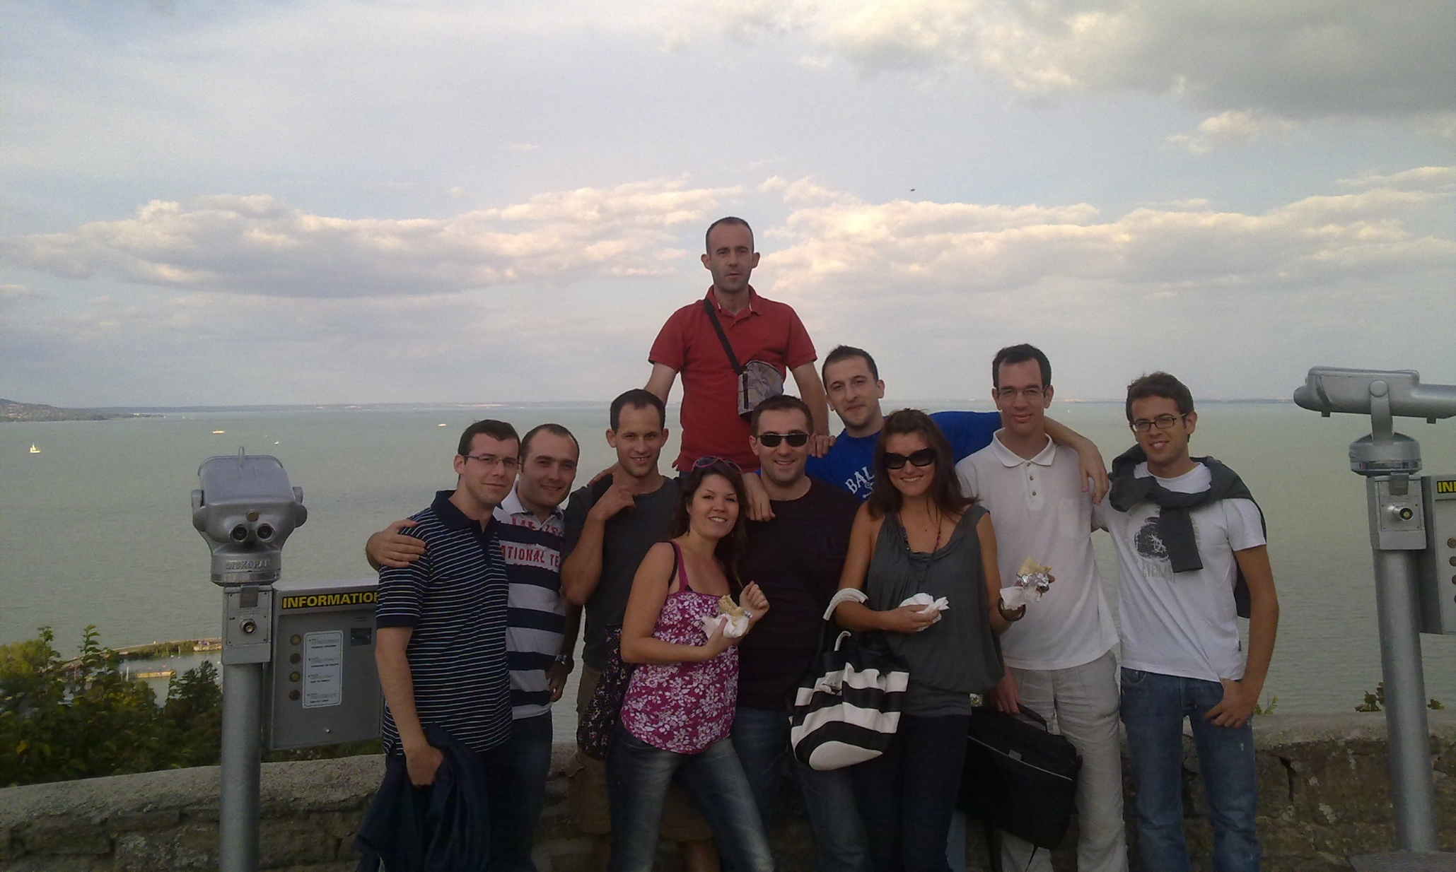
II edition

Slide 9
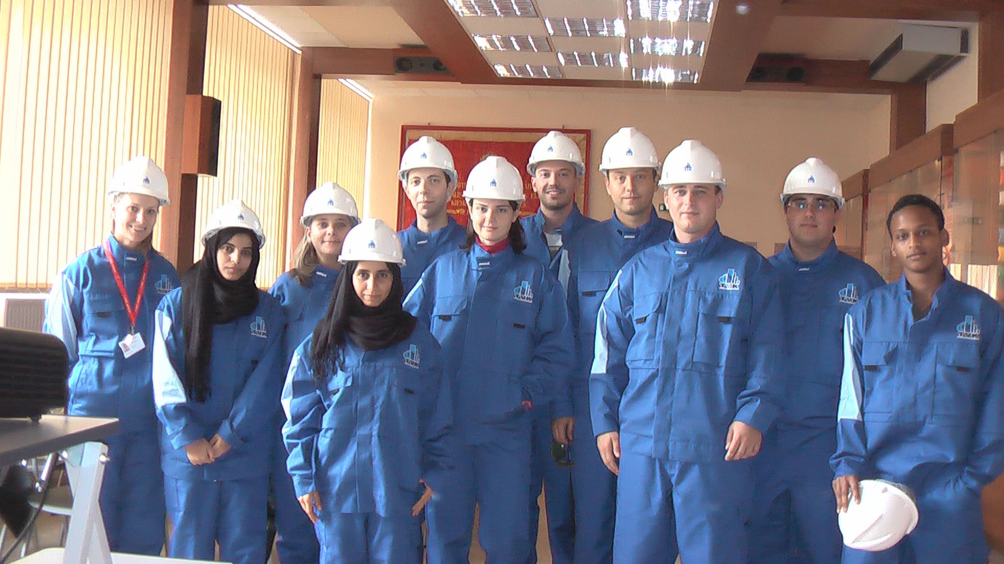
III edition

Slide 10
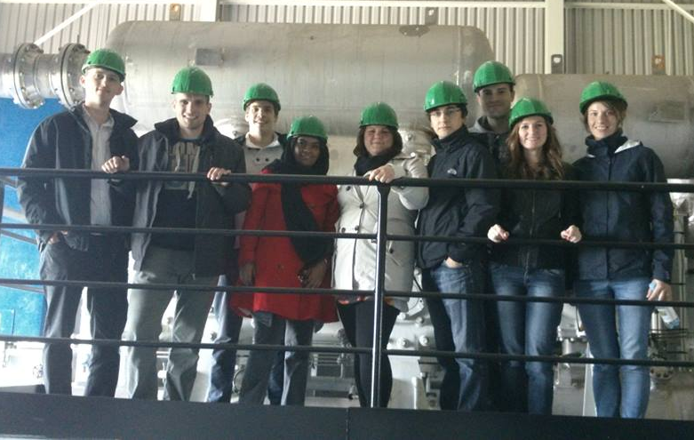
IV edition

Slide 11
But there is more about us...

Slide 12
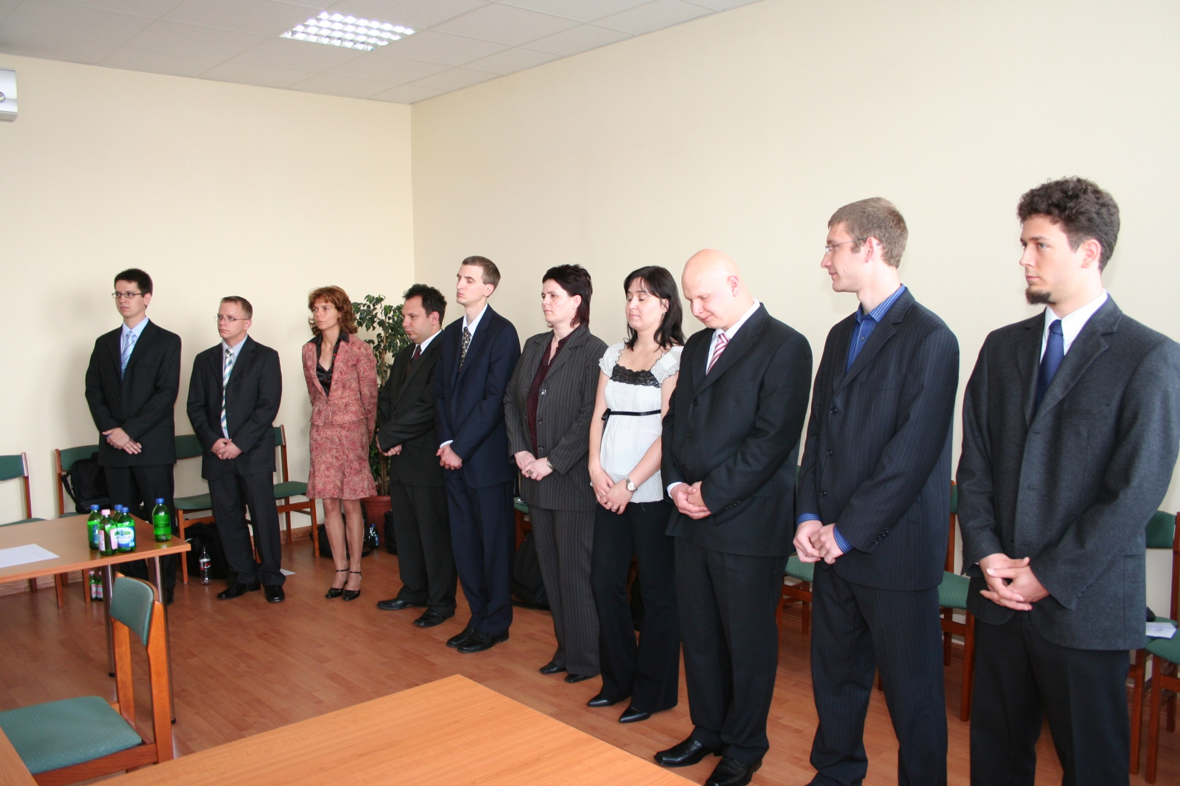
We feel unstoppable happines for our successes!

Slide 13
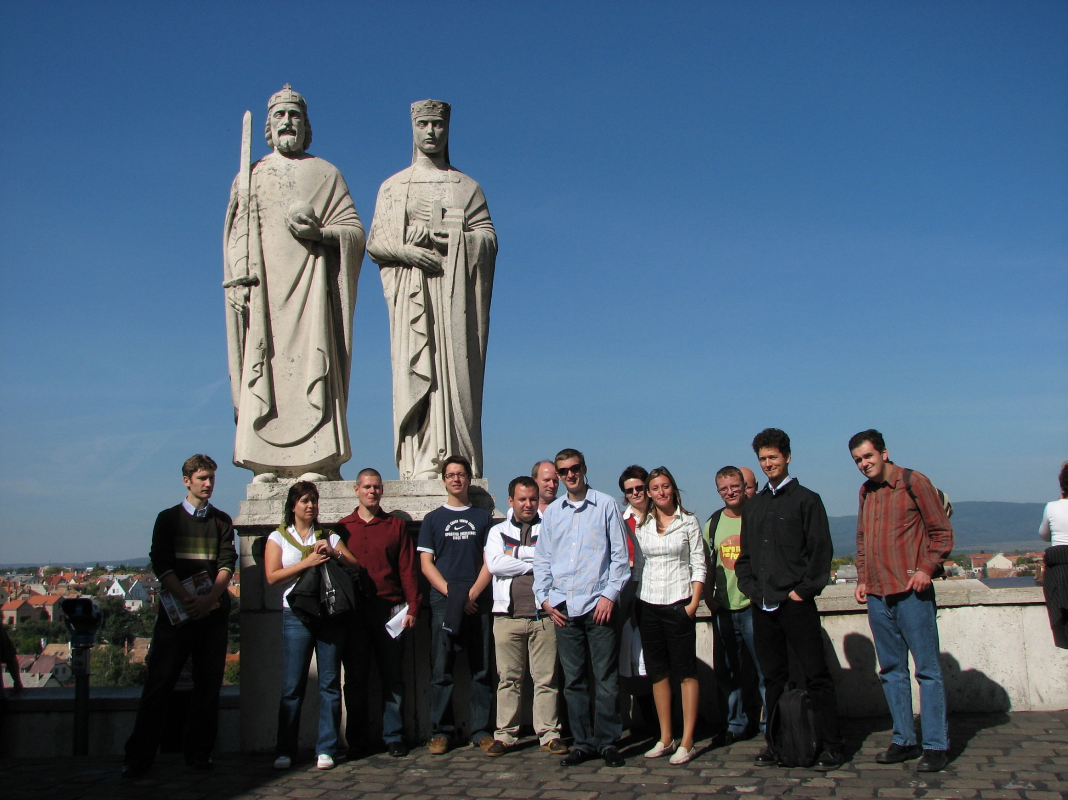
We enjoy
the company
of other V.I.P.

Slide 14
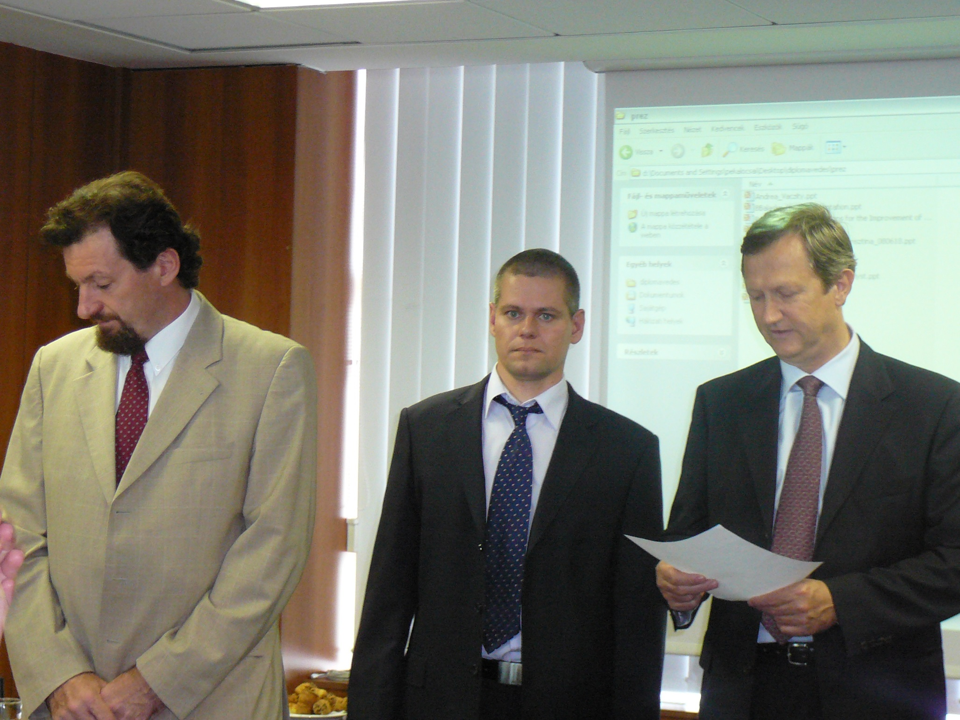
Shocked???
And you haven’t yet seen the rest...

Slide 15
We develop unexpected skills...
Like ninja’s ones!
Guess who is not a girl from Oman
(I will give you the solution later)

Slide 16
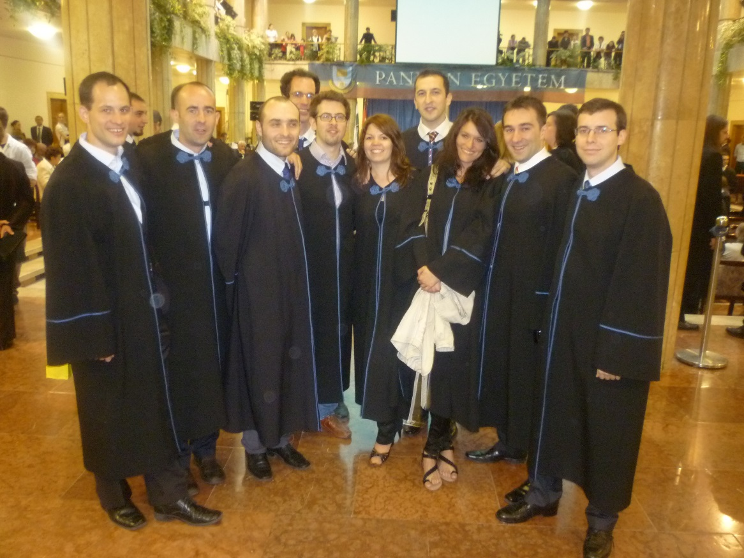
We are proud supporters of Harry Potter since generations!
Avada Kedavra!

Slide 17
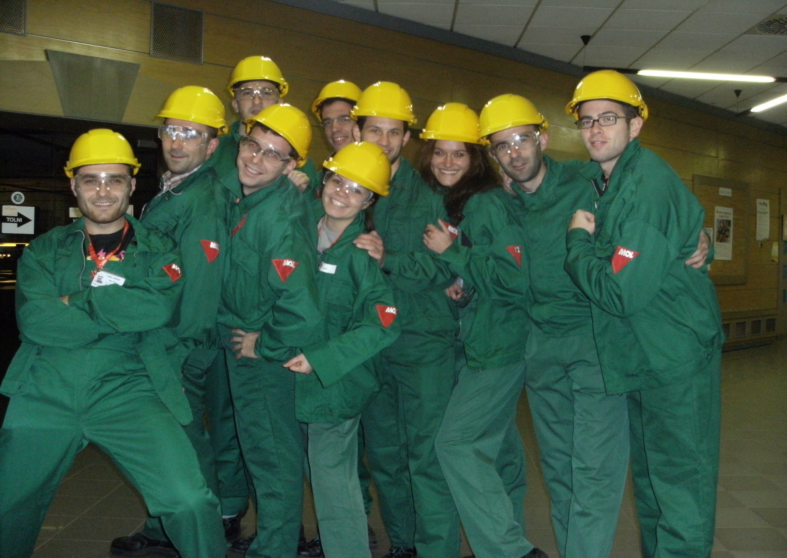
And we like Village People!

Slide 18
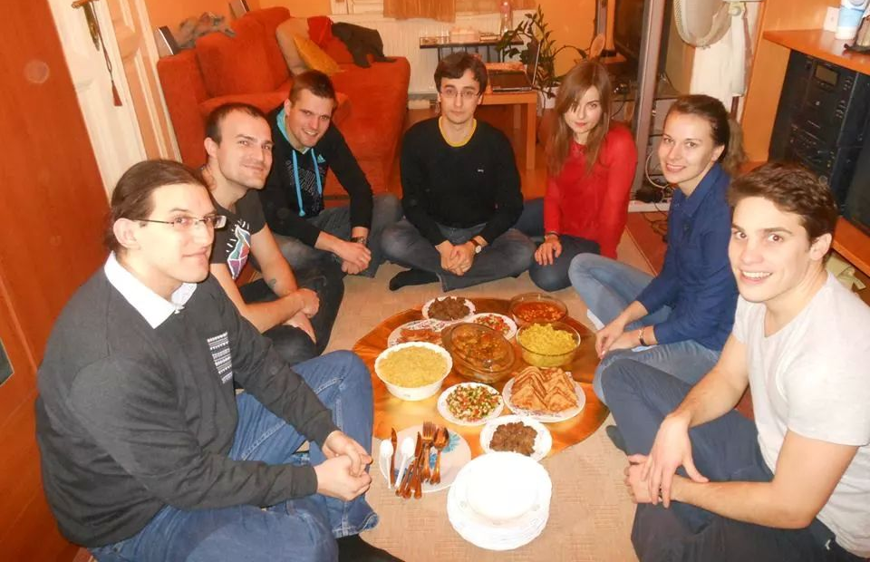
Than crisis arrived... so cut expenses!
Like chairs...

Slide 19
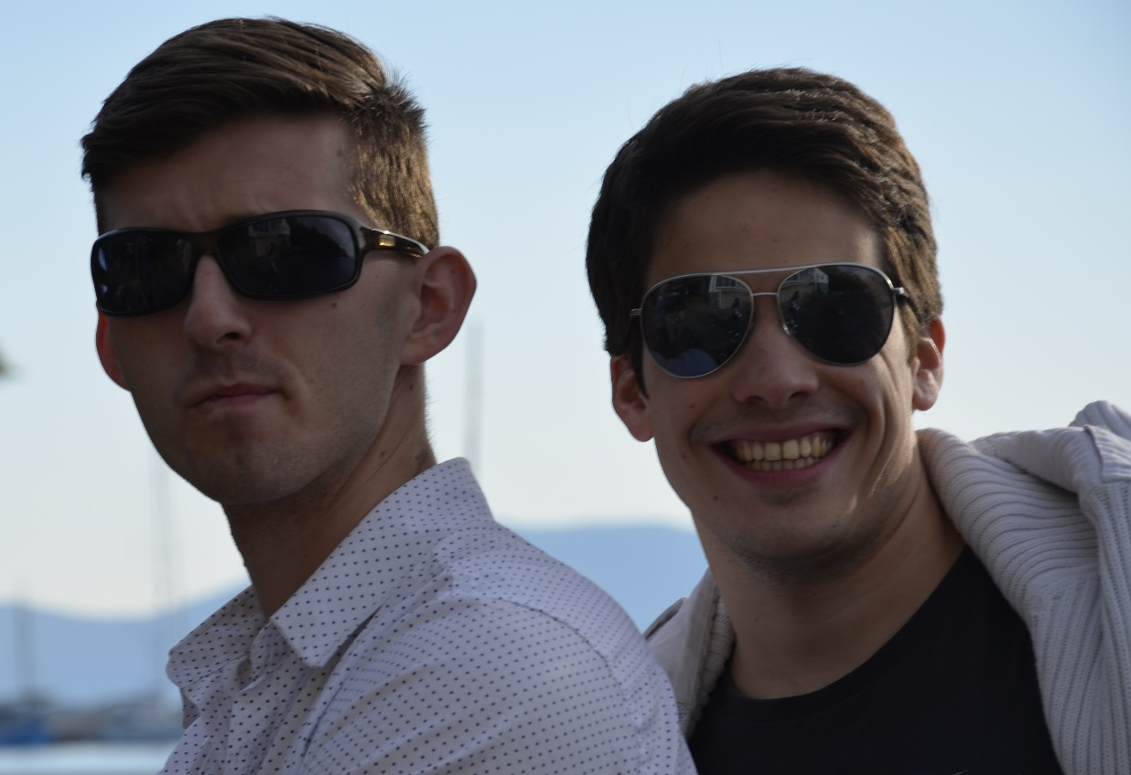
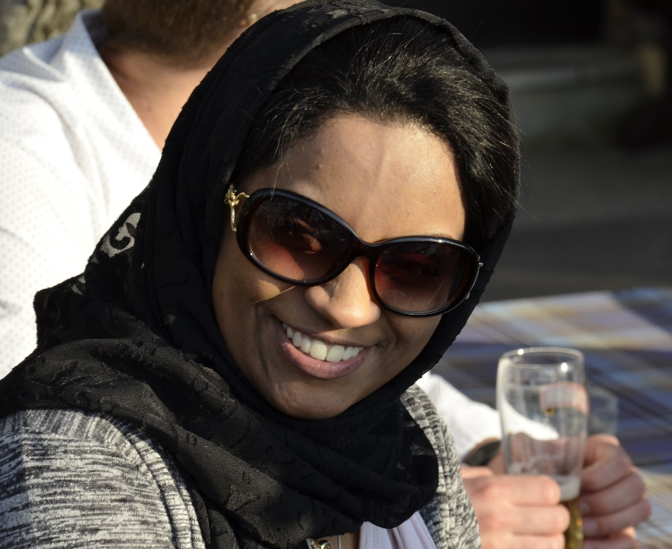
...that’s why we needed sponsors!

Slide 20
THANK YOU
FOR YOUR ATTENTION
MORE INFO
caravazzolo@mol.hu
Carlo Alberto Ravazzolo

